Slide 1
Clustering of Brokers
July 18th, 2016

Slide 2
Research Question
How to cluster Brokers according to sectors to better understand client behaviour?
Analysis:
Nb of sectors: 15
Nb of active brokers: 85 (72 brokers >100 trade days)
Tool: K-means and Hierarchical cluster

Slide 3
Distribution of trades for sectors.
% of investment

Slide 4
Distribution of trades for sectors (2015)
% of investment

Slide 5
Centroids based on
Trade Sector Distribution (2015).
% of investment
Nb of brokers in the cluster

Slide 6
Traders’ behaviour
Sector | Qty in May | Qty brokers held in Dec
Oil & Gas | 8 | 3
Mining | 6 | 2
Financial Serv. | 10 | 2
Div. Ind | 12 | 2
Total | 36 | 9
75% of the brokers changed clusters (between May & December).
During a single day, some brokers invested more than 80% in only a single sector, and changed the sector of interest after 6 months.
The distribution of the centroids also change throughout the year.

Slide 7
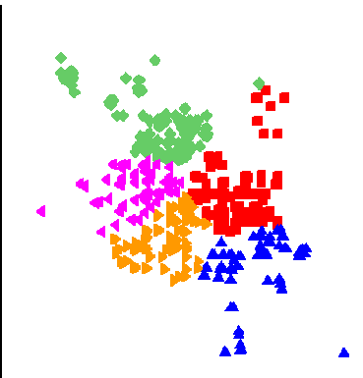
Traders’ Behaviour Analysis
5 clusters were generated each trade-day based on the sector distribution.
The positions of centroids consistently changed throughout the time period.
Each broker was associated to the closest cluster.
The brokers were again clustered, based on the amount of the time they were clustered with other firms (using hierarchical clustering).

Slide 8
Results
Cluster 1: the stocks remained 93% (avg) of the time period in the same cluster (min = 87%)
 | Name | Volume (2015)
1 | RBC Capital Markets | 218,892,926,097
2 | TD Securities Inc | 246,534,898,355
3 | Barclays Capital Canada Inc | 24,165,214,315
4 | UBS Securities Canada Inc | 41,420,419,443
5 | Instinet Canada Ltd | 84,296,044,275
6 | Broker nb 1 | 535,186,026,461
7 | CIBC World Markets Inc | 501,144,449,342
8 | Credit Suisse Securities | 57,450,353,318
9 | Merrill Lynch Canada Inc | 99,452,871,523
10 | Morgan Stanley Canada Ltd | 97,356,027,641

Slide 9
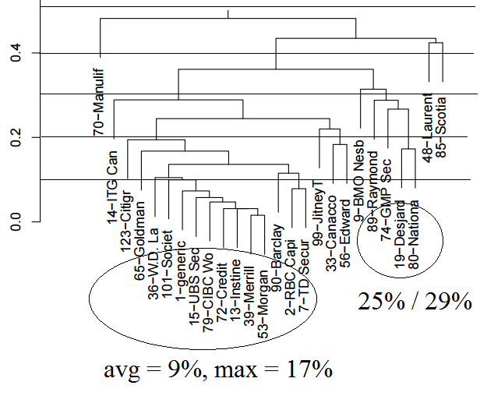
Cluster 1 (expanded)
The Brokers from sub-cluster 1.1 were not in the same group only 9% of the time on average (max: 17%).
Portion of the days in different clusters
Sub-cluster1.1

Slide 10
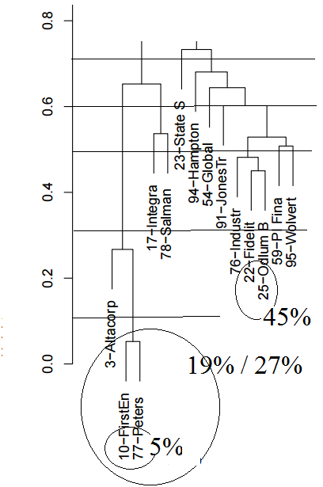
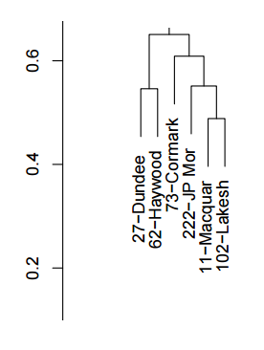
Clusters 2 and 3
Portion of the days in different clusters
The brokers 10 and 77 remained together over 95% of the time period.

Slide 11
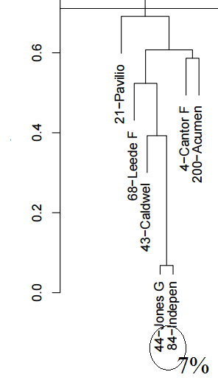
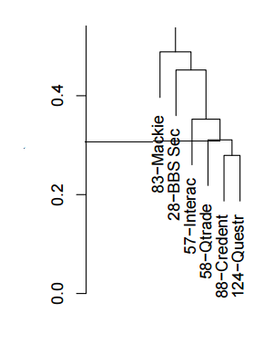
Clusters 4 and 5
Portion of the days in different clusters
Cluster 4: the Brokers 44 and 84 were in different groups only 7% of the time.

Slide 12
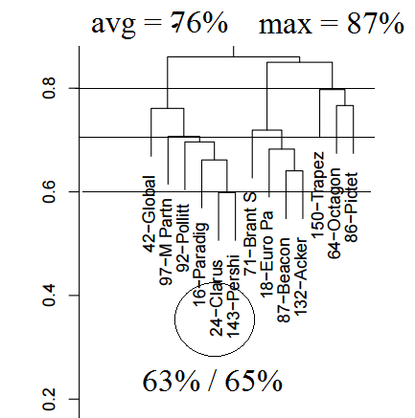
Cluster 6
Portion of the days in different clusters
No broker remained together in the same cluster more than 40% of the time.

Slide 13
Conclusion
The distribution of the centroids (clusters) changed throughout the year.
But some traders remained together, even when they changed the cluster.
31 brokers remained together in the same cluster during 30% of the time period.
The closest neighbours of some brokers changed throughout the time period (illustration below).
cluster
broker
cluster

Slide 14
Research Question
What interesting results can result from clustering brokers based on different metrics?
Method: Apply various clustering algorithms in combination with a multitude of metrics

Slide 15
Metrics
2 main groups of metrics are used:
  Sector
    Used to cluster via portion of purchases/sells of each sector in a given period of time
  QMV – Quoted Market Value
    Split into 2 sub-metrics; average QMV for purchased stocks, and average QMV for sold stocks,

Slide 16
Method
The Method used consists of first applying k-means clustering and splitting the groups into subsets, and then applying hierarchal clustering.
The data used is intraday trading data compounded over 10 random days in 2015.

Slide 17
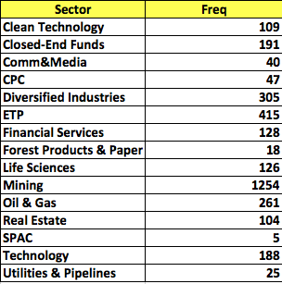
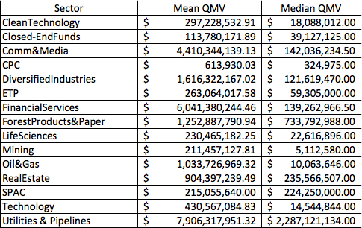

Summary Statistics for QMV

Slide 18
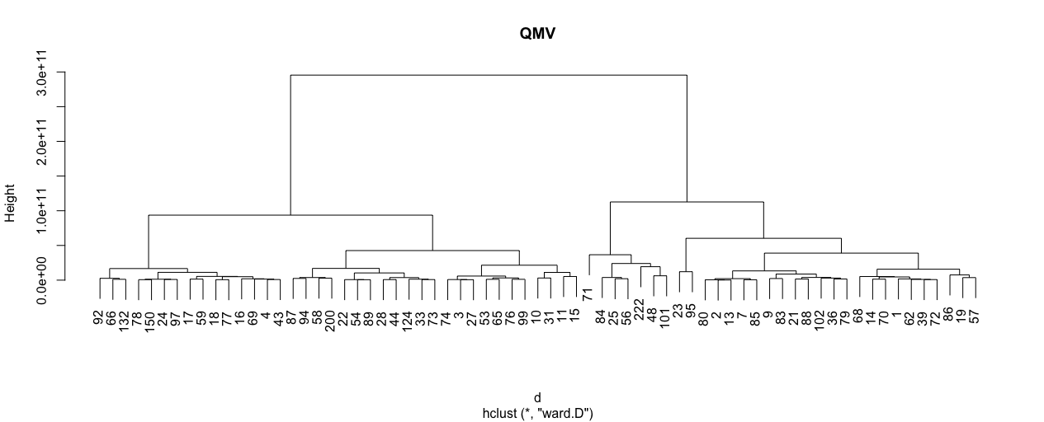



Clustering all Brokers by QMV
Brokers that fall on the Right tend to trade stocks with greater QMV
Brokers that fall on the left tend to trade stocks with smaller QMV

Slide 19


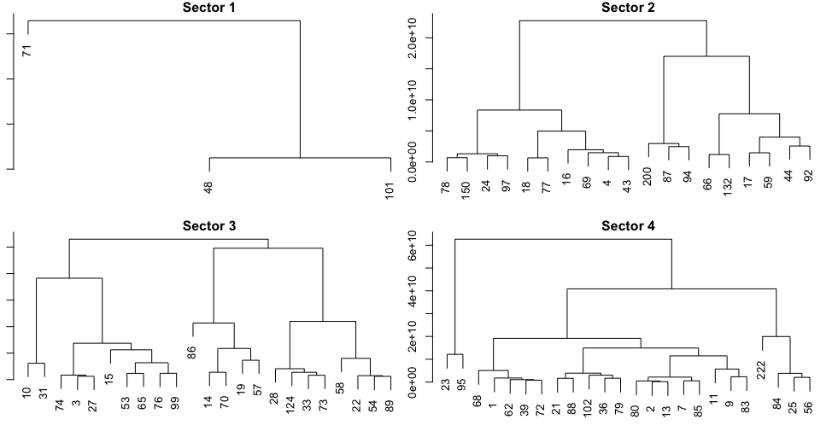




QMV with K-means followed by H-clustering
Cluster 1: Outliers, mostly trade stocks with large QMV
Cluster 2: Trades stocks with QMV near average
Cluster 3: tends to trade stocks below average QMV
Cluster 4: tends to trade stocks above average QMV

Slide 20
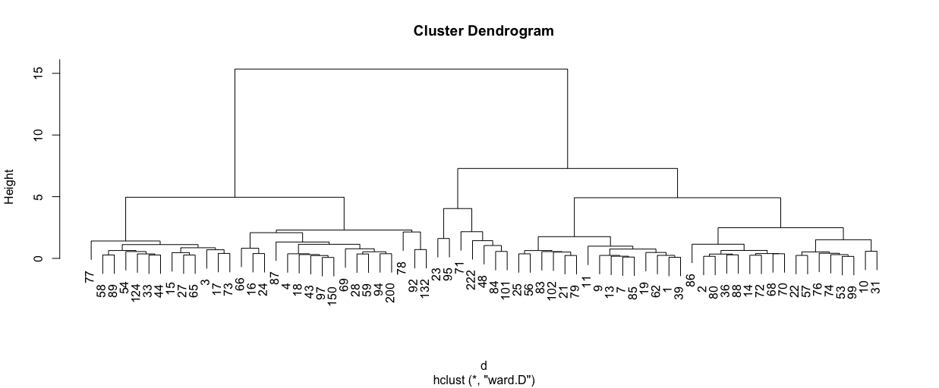



Combining Sectors and QMV
QMV tends to show a less definitive pattern

Slide 21
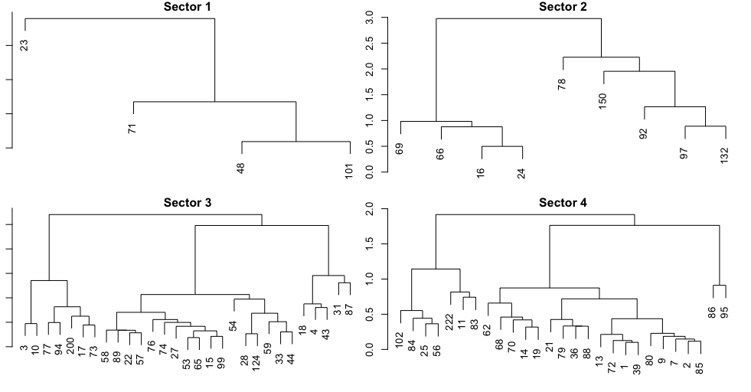




Combo with Clusters
Outliers, tending to trade very large QMV
Cluster 2: Trades smaller QMV’s

Slide 22
Results
K-means followed by Hierarchal tends to do an interesting job of clustering brokers.
Augmenting clustering by QMV by adding Sectors leads to some changes, but not many dramatic changes, ~ 78% stayed within the same sector.
This is somewhat expected, as QMV is correlated with Sector.
The results shown are different from the results given when clustering broker just by size.

